Slide 1

OBJECT ORIENTED MODELLING & DESIGN (OOMD)
SOFTWARE TESTING
UE18CS400SB
Prof. Venkatesh Prasad
venkateshprasad@pes.edu
Department of Computer Science

Slide 2
“We are lucky to find errors in our testing.
Because, it is so much better than customer finding it”

Slide 3
Integration Testing
Topics:
Integration Testing: Overview
Types of integration Testing - top-down, bottom-up, Functional, Bi-directional, System Integration.
Scenario Testing.

Slide 4
WHAT IS INTEGRATION TESTING
Integration: the act, or process or an instance of integrating
Integrate: to form, coordinate or blend into a functioning or unified whole
Typically a software system is made of several “blocks”. These blocks are “integrated” to form a whole system.
Integration testing means testing a partially built system.
With the idea of ?

Slide 5
WHAT IS INTEGRATION TESTING
As Testing Type
Based on Target - “ What”
Testing of units / components/ modules after integrating them together – at any level
Once integrated, appropriate technique (“How” ) is used to test
As Testing Phase
Since this activity is an important intermediate stage in STLC that needs special focus

Slide 6
NEED FOR INTEGRATION TESTING
Integration testing uncovers inter-component interface and functional problems.
Potential problems with external interfaces can be identified at earlier stage
Since one deals with partially built system, some of the system-level problems could be discovered at earlier stage

Slide 7
INTEGRATION TESTING - OVERvIEW
Concept is driven by
Software making process
Software complexity
Software/Technology solution Marketplace

Slide 8
INTEGRATION TESTING - ERRORS
Errors that are caught in Integration testing
Interface mismatch – Parameters / return value – order, type and other semantics
Missing interfaces
Service invocation protocol mismatch
Error handling across the interfaces
Errors due to deployed environment
Initializations, closures
Configuration errors
Errors related to “emergent properties” are not caught this way.

Slide 9
INTEGRATION TESTING - ERRORS
Error manifestations
Direct system messages
“… Not found”, “… wrong parameter…”
“..Contact System administrator”
Functional misbehavior
Run-time errors
May not manifest / detect also

Slide 10
INTEGRATION TESTING - TESTING OF INTERFACES
Internal interfaces
The interfaces that are provided for use by other devs / components
Provides communication across two or more modules
Not exposed to the customers
Needs complete understanding of design & architecture
External interfaces
The interfaces provided for use by other system/products
Used by third-party developers, solution providers
You need to understand why they are provided and how they can be used
APIs / SDKs / scripts / queries / dynamically created scripts / Web services

Slide 11
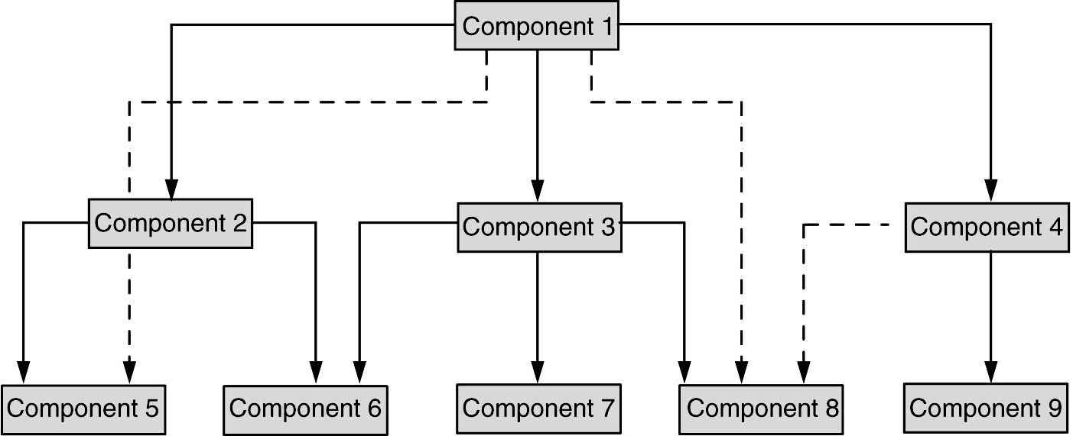
INTEGRATION TESTING - TESTING OF INTERFACES

Slide 12
INTEGRATION TESTING - METHODS
Integration sequence depends on a number of factors:
Test strategy
Project plan compulsions
Dev methodology – agile / spiral…
Actual project progress
External / customer dependency
Testing Resource availability
Testing method?

Slide 13
INTEGRATION TESTING - METHODS
Integration sequence depends on a number of factors:
Test strategy
Project plan compulsions
Dev methodology – agile / spiral…
Actual project progress
External / customer dependency
Testing Resource availability
Testing method?
A systematic approach
Top down
Bottom up
Bi-Directional
System Integration
All are incremental – except System Integration

Slide 14
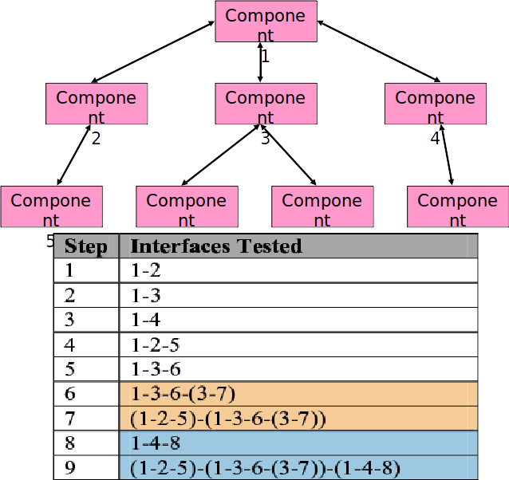
TOP DOWN INTEGRATION

Slide 15
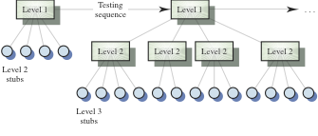
TOP DOWN APPROACH - Highest Level are Integrated first

Slide 16
ISSUES IN TOP DOWN INTEGRATION
If some unit/component not available, “stub” required
Some parts may be treated as sub-system
Breadth first – depth first

Slide 17
ISSUES IN TOP DOWN INTEGRATION
Advantages:
High-level logic and data flow is tested early in the process.
It tends to minimize the need for drivers.
Early skeletal program allows demonstration of click-thru prototype and boosts morale of developers and end users.
The coverage of test cases improve without any changes as new modules are added at the bottom.
Disadvantages:
Need for stubs complicates testing effort.
Difficult to observe the flow of data.
Low-level utilities are tested relatively late in the development cycle.
Since low level functions are not needed upfront, they may be designed at later stage which is not a good practice.
Poor support for early release of limited functionality

Slide 18
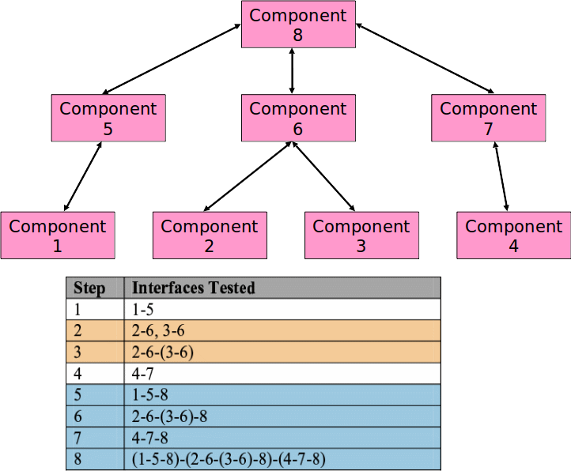
BOTTOM UP INTEGRATION

Slide 19
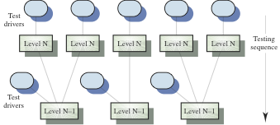
BOTTOM UP INTEGRATION

Slide 20
ISSUES IN BOTTOM UP INTEGRATION
Quite suited for agile kind of methodologies
If some unit/component not available, “stub” required
From quality perspective, better approach as the ‘leaf nodes’ get tested many times.

Slide 21
BOTTOM UP INTEGRATION
Advantages:
Utility modules are tested early in the development process
Need for stubs is minimized
It is easier to observe the flow of data
Disadvantages:
Need for drivers complicates testing efforts
High-level logic and data flow are tested late
A demonstrable program can be created only after last (top) module is added
Many loose integration segments to be managed
Like the top-down approach, the bottom-up approach also provides poor support for early release of limited functionality

Slide 22
INCREMENTAL INTEGRATION
Advantages:
Programming errors related to mismatching interfaces or incorrect assumptions among modules will be detected earlier.
Debugging is easier.
It offers more flexibility.
It enables more efficient use of resources.
Both technically and managerially this is preferred to “big-bang” /System level

Slide 23
SYSTEM INTEGRATION
System integration means that all the components of the system are integrated together and tested as an entire unit.
Advantages:
Saves time & effort.
Disadvantages:
When a failure or defect is encountered during system integration test , it is very difficult to locate the problem.
The ownership for correcting the root cause of the defect may be an issue difficult to pinpoint.
When integration testing happens in the end, the pressure for approaching release date is very high and may affect quality.
A certain component may take excessive amount of time to get ready. This precludes testing other interfaces and integration testing waits till the end.

Slide 24
Scenario Testing
Software Testing Technique that uses scenarios i.e. speculative stories to help the tester work through a complicated problem or test system.
The ideal scenario test is a reliable, complicated, convincing or motivating story the outcome of which is easy to assess.
Usually these tests are different from test cases as the test cases are single steps whereas scenarios cover a number of steps.
Scenario testing is carried out by creating test scenarios which copy the end users usage.
A test scenario is a story which describes the usage of the software by an end user.
Example: Hospital Management System
https://softwaretestingmentor.com/what-is-scenario-testing/
Ecommerce application
Test scenarios for a Banking Site
https://www.guru99.com/test-scenario.html

Slide 25
Strategies to Create Good Scenarios
Enumerate possible users their actions and objectives
Evaluate users with hacker's mindset and list possible scenarios of system abuse.
List the system events and how does the system handle such requests.
List benefits and create end-to-end tasks to check them.
Read about similar systems and their behaviour.
Studying complaints about competitor's products and their predecessor.
For each requirement, figure out possible users actions and objectives.
Determine the technical aspects of the requirement.
Ascertain possible scenarios of system abuse and evaluate users with hacker’s mindset.

Slide 26
Scenario Testing (Cont.)
A scenario test has five key characteristics:
Story
Motivating
Credible
Complex
Easy to evaluate
Risks of Scenario Testing:
Scenario testing is complex involving many features.
Scenario testing is not designed for coverage of the program or for test coverage.
Scenario testing is often heavily documented and used time and again.
When the product is unstable, scenario testing becomes complicated.

Slide 27
OBJECT ORIENTED MODELLING & DESIGN (OOMD)
THANK YOU
Prof. Venkatesh Prasad
venkateshprasad@pes.edu
Department of Computer Science

